Slide 1
History of Debt During Modern U.S Recessions

Slide 2
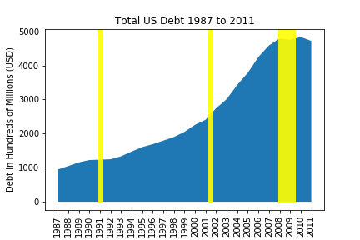

Slide 3
